Slide 1
CCA - ROSMAP
April 2025

Slide 2
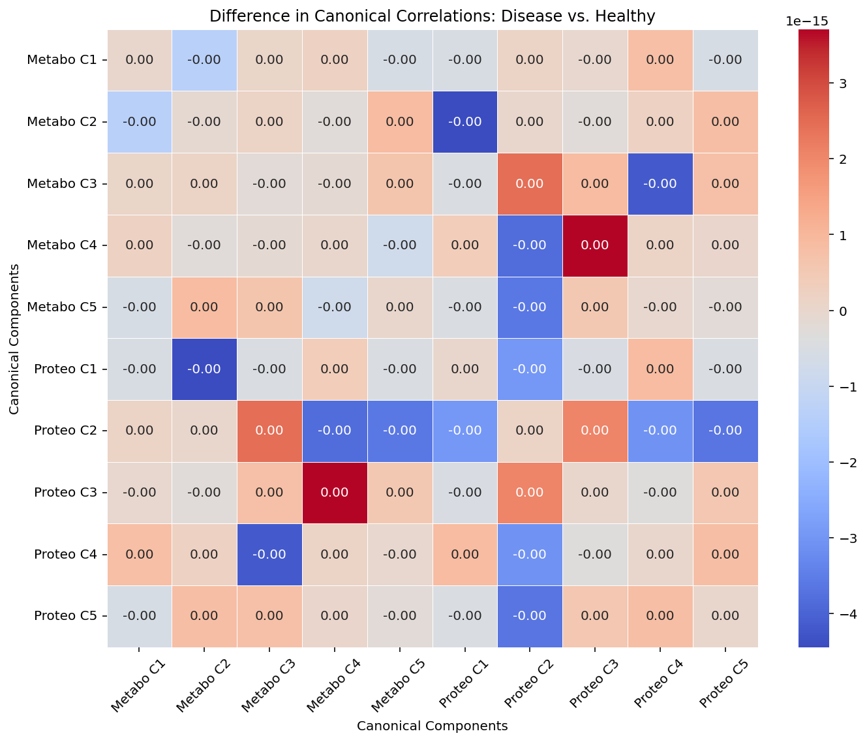
More metabolite-protein correlation in disease
Metabolite component 4 vs. Protein component 8

Slide 3
More metabolite-protein correlation in disease
Heatmaps comparing correlation between top 20 metabolites/proteins in relevant components
One heatmap for disease (more uniform)
One heatmap for healthy (more heterogeneous)
Correlation coefficients are too small -> likely just noise!

Slide 4
More metabolite-protein correlation in healthy
Metabolite component 6 vs. Protein component 2
Metabolite component 9 vs. Protein component 3

Slide 5
More metabolite-protein correlation in healthy
Heatmaps comparing correlation between top 20 metabolites/proteins in relevant components
One heatmap for disease (more heterogeneous)
One heatmap for healthy (more uniform)
Correlation coefficients are too small -> likely just noise!

